Slide 1
PROJECT ON
FUSIONPOINT INDUSTRIES

Slide 2
INTRODUCTION
Aims/objectives
Analyze sales performance across products, sub-categories, and regions to
identify high- and low-performing segments.
Measure profitability trends by product category, sub-category, and sales channel to support profit-driven decision-making.
Evaluate customer purchasing behavior and payment preferences to inform customer-centric strategies.
Identify patterns in demand over time and across geographies to optimize inventory and supply chain planning.
Assess the impact of discounts and pricing on revenue and profit margins.

Slide 3
AIM/OBJECTIVES
Analyze sales performance across products, sub-categories, and regions to identify high- and low-performing segments.
Identify high- and low-performing segments.
Measure profitability trends by product category, sub-category, and sales channel to support profit-driven decision-making
Evaluate customer purchasing behavior and payment preferences to inform customer-centric strategies.
Identify patterns in demand over time and across geographies to optimize inventory and supply chain planning.
Assess the impact of discounts and pricing on revenue and profit margins.

Slide 4
Analyze sales performance across products, sub-categories, and regions to identify high- and low-performing segments.
INSIGHTS
Markers, Pens, and Sofas are the top-performing sub-categories by profit.
States like California, Florida, and New York consistently drive the majority of sales.
Several sub-categories (e.g. Binders, chairs & Bookcases) contribute minimal Profits, suggesting underperformance or niche appeal.
RECOMMEDATIONS
Focus marketing and inventory investment on high-performing sub-categories.
Evaluate the viability of low-performing products: reposition, bundle, or phase out.
Strengthen regional campaigns in high-revenue states to increase market share.

Slide 5
Identify high- and low-performing segments.
INSIGHTS
Profit does not always correlate with high revenue – some high-selling items have low profit margins.
Debit Card is the most frequently used payment method and may attract lower transaction costs, improving net profitability.
RECOMMEDATIONS
Promote and upsell products with high profit-to-sales ratio.
Consider discount restrictions on low-margin items. Negotiate better rates or incentives with high-usage payment channels.

Slide 6
Measure profitability trends by product category, sub-category, and sales channel to support profit-driven decision-making
INSIGHTS
Electronics generate the highest sales, but profit margins vary widely across sub-categories. Apparel shows modest sales, but often with stronger margins due to lower cost structure.
Markers & Pens may have sporadic high profits due to seasonal spikes or lower costs.
Debit cards dominates as a payment mode, associated with high transaction volume. Profit margins are similar across channels, but EMI & Credit card may show lower profitability — possibly due to charges or fees.
RECOMMEDATION
Focus growth efforts on profitable categories, not just high-revenue ones
Encourage continued use of Debit Cards through promotions or loyalty perks. Analyze transaction fees per channel — optimize toward low-cost channels.
Consider offering incentives for profitable payment types if fees differ.

Slide 7
Identify patterns in demand over time and across geographies to optimize inventory and supply chain planning
INSIGHTS
High demand in California, Texas, and New York. Some states have repeat orders from the same customers, indicating brand loyalty or local market fit.
Low demand in smaller states could indicate logistics or awareness gaps.
RECOMMEDATIONS
🚚 Prioritize warehouse placement or local suppliers near high-demand regions to reduce shipping costs and lead time.
📦 Stock regional favorites (e.g., popular electronics in Texas) based on historical data.
🛒 In low-performing areas, consider online-exclusive inventory or awareness campaigns instead of heavy local stocking.
🔄 Build regional reorder logic — don't apply national restock policies uniformly.

Slide 8
Assess the impact of discounts and pricing on revenue and profit margins.
INSIGHTS
Some products (like Pens & Phones) show low or negative profit margins despite notable sales. Other products (e.g., Printers, Papers) deliver higher profit margins, suggesting less discounting or better cost control.
High sales but low profit = potential excessive discounting or price undercutting.
RECOMEDATIONS
🔴 Reevaluate pricing or discount strategy for low-margin, high-volume items (e.g., Cameras).
🟢 Increase visibility and promotions on high-margin categories.
🧪 A/B test price sensitivity by region or product group.
📈 For popular but unprofitable products, explore premium add-ons or bundles to recoup margins.

Slide 9
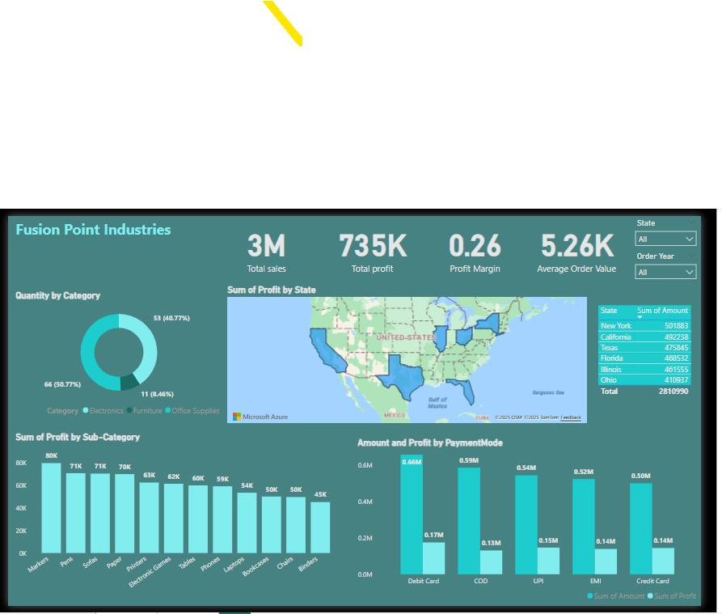
DASHBOARD 1
.

Slide 10
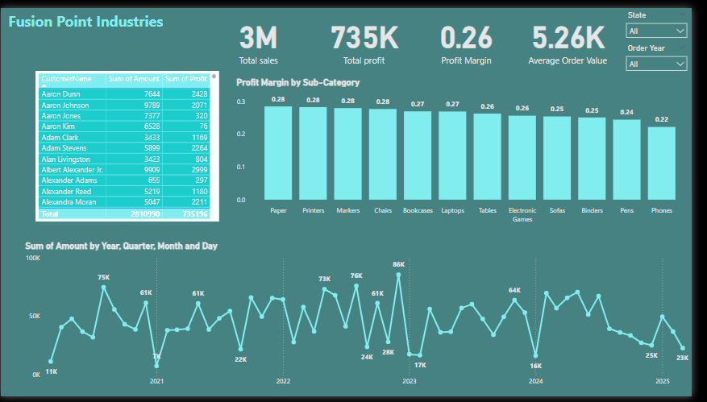
DASHBOARD 2
.

